Slide 1
A Practical Approach to Timeseries Forecasting using Python
Module #4
Downloading the Dataset
Manipulation in the Dataset
Data Preprocessing
RVT in Time Series in Python
Feature Engineering and Stationarity in Time Series
Shahzaib Hamid

Slide 2
Importance of Dataset
The lack of quality and quantitative datasets are a cause of concern.
Strong Dataset offer robust operations, evaluations, testing and trainings.
Following are the famous platforms for authenticated datasets
2. Famous platforms for authenticated datasets
https://www.kaggle.com/datasets
https://github.com/A-I-Studio/Datasets
https://huggingface.co/datasets
https://www.worlddata.info

Slide 3
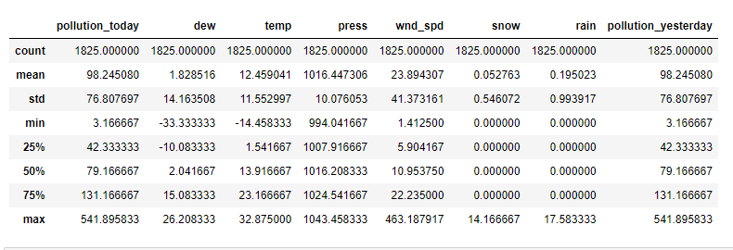
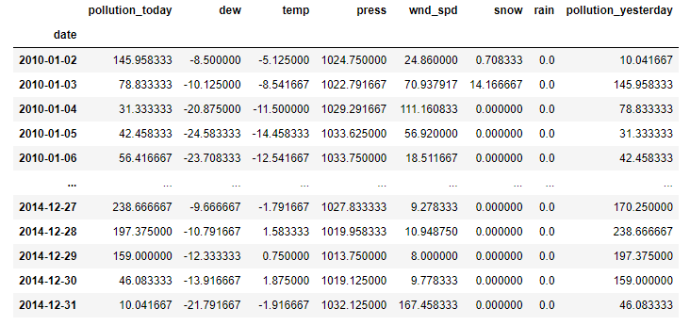
Data Manipulation
Basic Commands:
air_pollution.columns
air_pollution.describe()
pd.DataFrame(air_pollution)

Slide 4
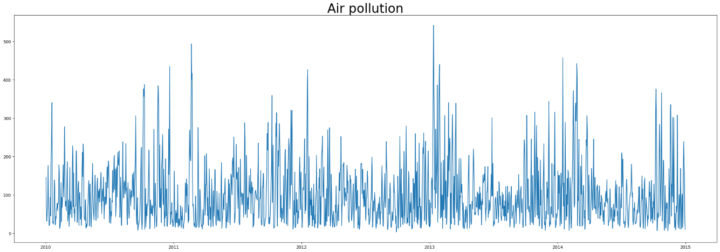
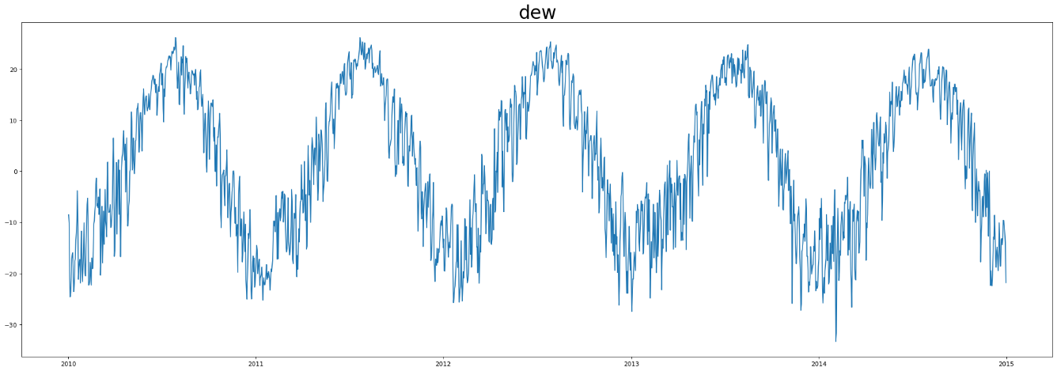
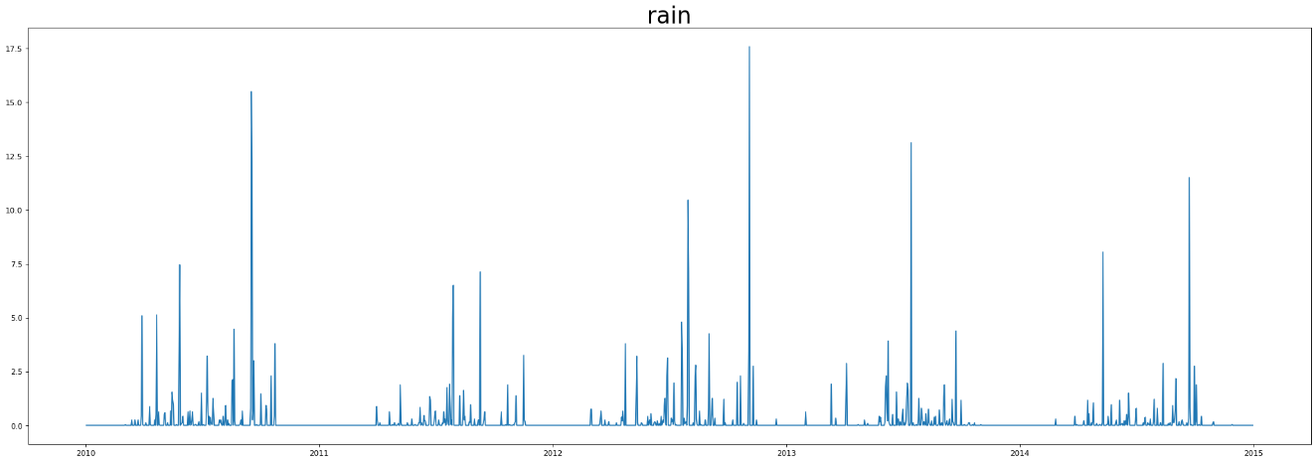
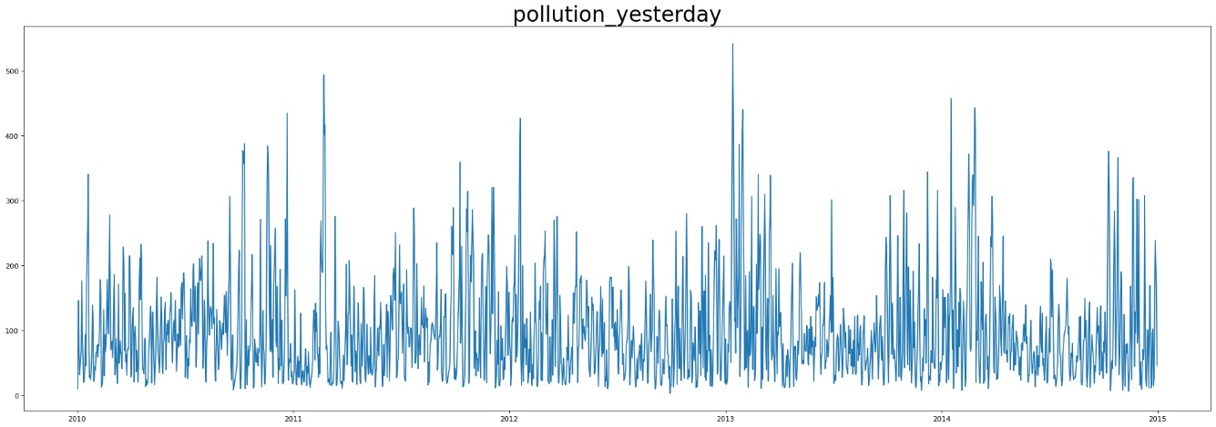
Data Preprocessing
1. Data Cleaning
2. Row and Column Handling
3. Data Visualization for the Dataset in Python

Slide 5
Resampling, Visualize and Transform (RVT)
Core Objective: To decompose our series
The parts we can divide a time series into are:
Level
Trend
Seasonality and
Noise
This part combine either additively or multiplicatively into the time series.
Additive Model y(t) = Level + Trend + Seasonality + Noise
Mupltiplicative model y(t) = Level * Trend * Seasonality * Noise

Slide 6
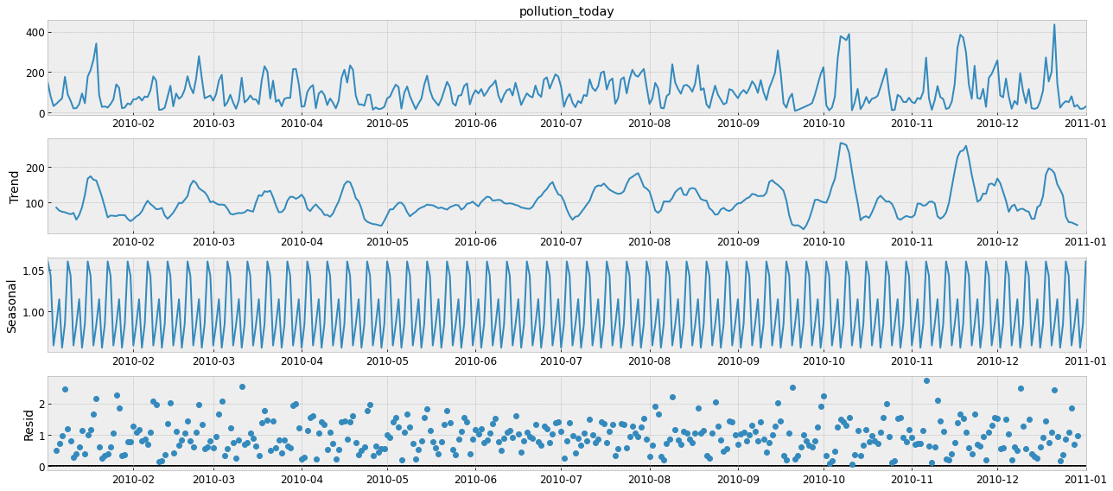
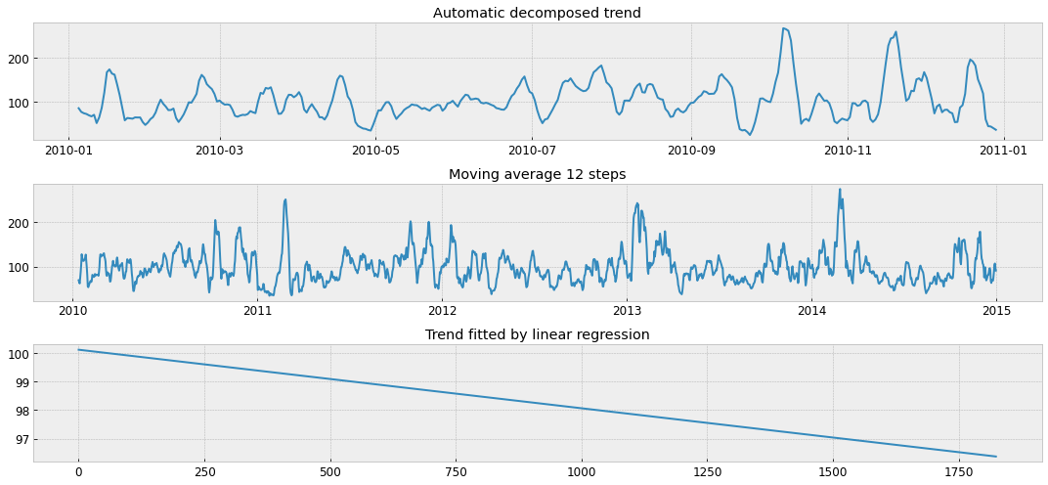
Automatic Time Series Decomposition
Here we will use Statsmodel.
Trend in Automatic Time Series Decomposition using Moving Average Filter
Seasonality
Noise in Automatic Time Series Decomposition

Slide 7
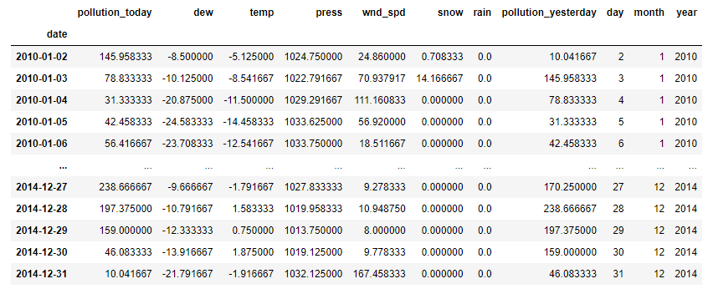
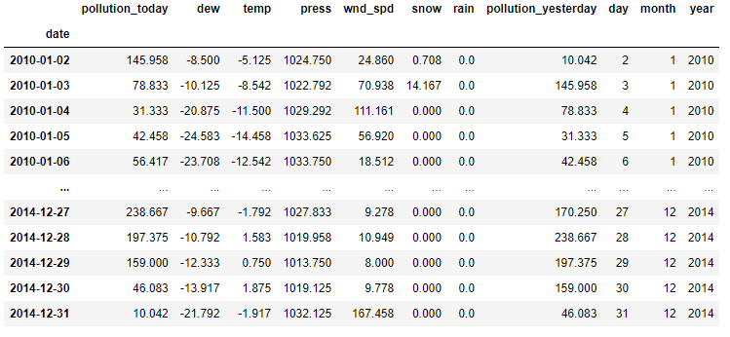
Feature Engineering
Handling missing values
Handling outliers
Combining numeric variable
Encoding categorical feature
Numerical transformations
Calling numerical features

Slide 8
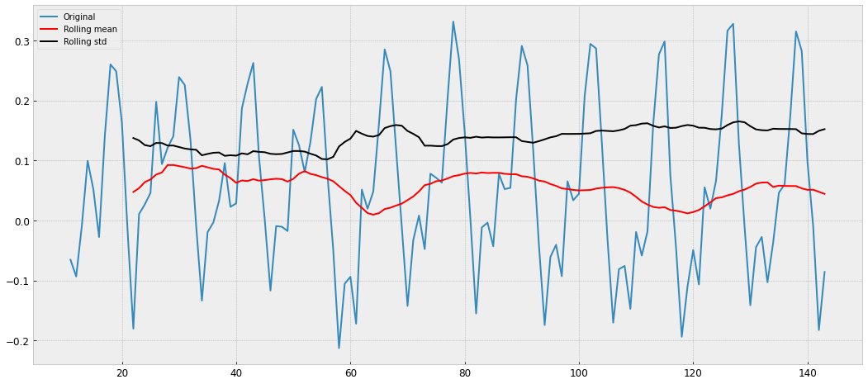
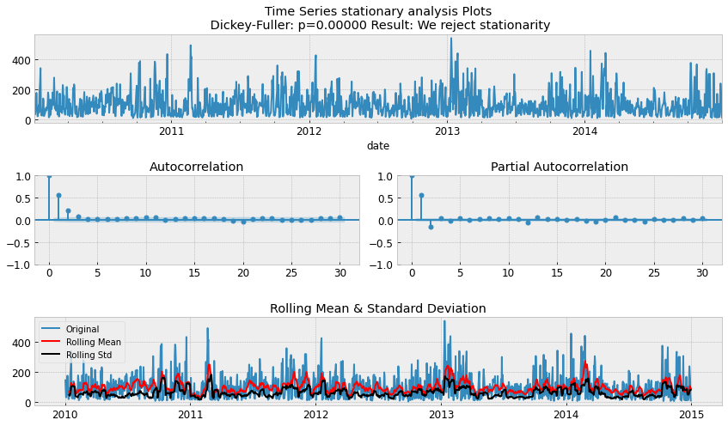
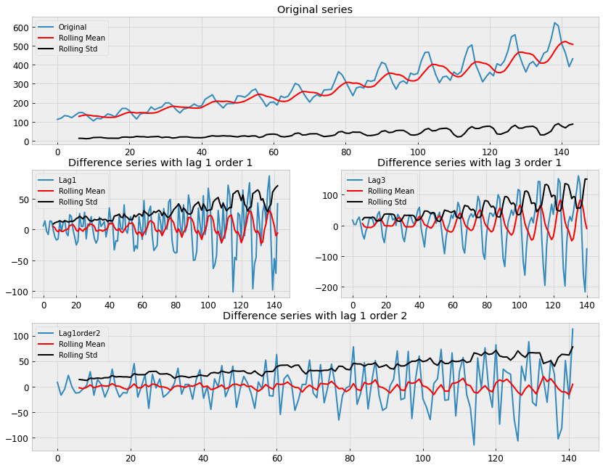
Stationarity in Time Series
Check Stationarity
Rolling means and standard deviation of our series
Augmented Dickey-Fuller test
Make any time series a Stationary Time Series
Log Scale Transformation
Smoothing

